Slide 1
CFS Load balancer
Domain, group scheduling, Bandwidth control, PELT load tracking
국민대학교 임베디드 연구실
경 주 현
2017 LG MC 인재육성팀 교육

Slide 2
Outline
Load balancer
CFS load balancer
Schedule domain
Group scheduling
Bandwidth control
PELT load tracking

Slide 3
On multi-core systems
On a single-CPU system
CFS is very simple.
On multi-CPU systems
CFS becomes quite complex

Slide 4
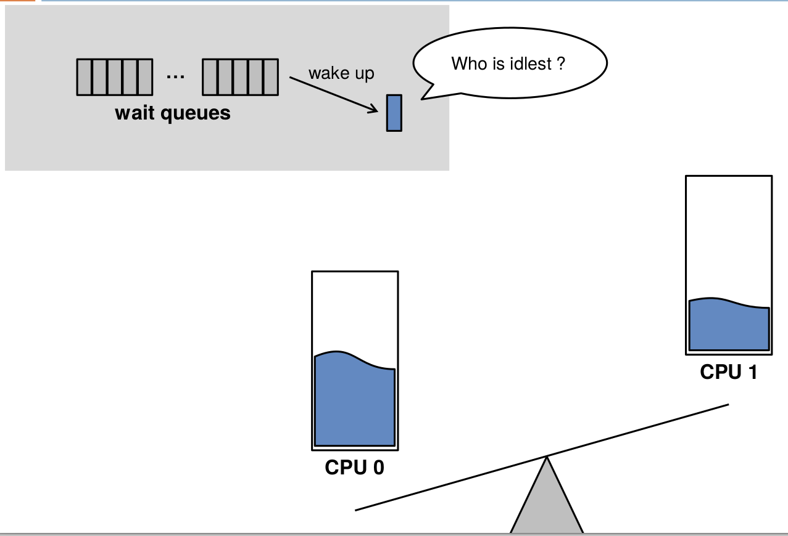
Load Balancing - review
"Energy Aware Scheduling", Byungchul Park, LG Electronic

Slide 5
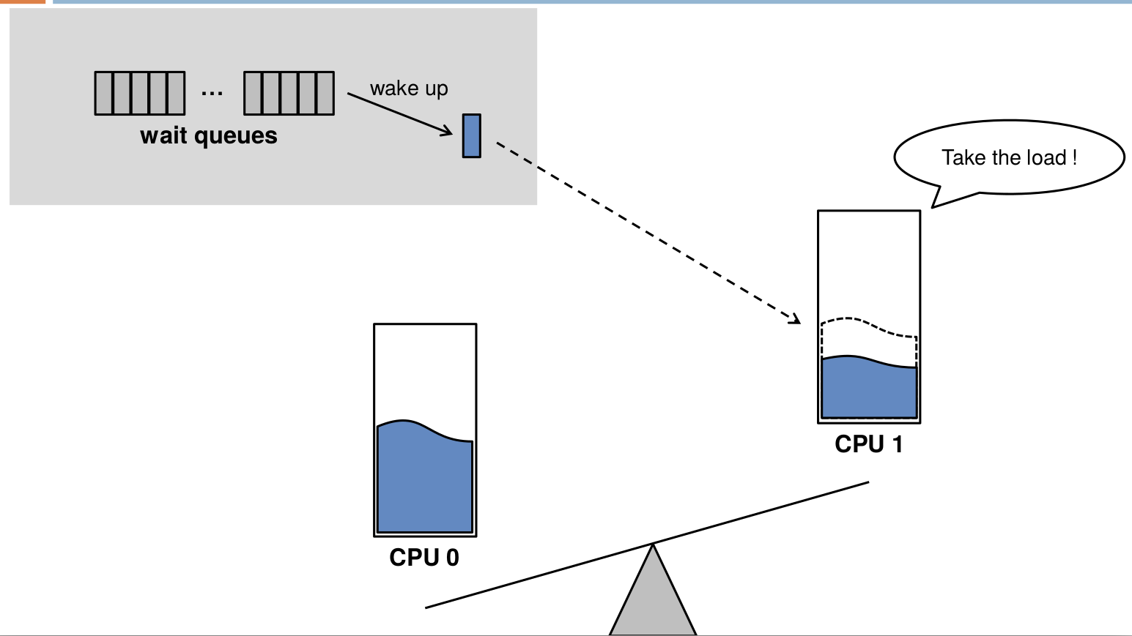
Load Balancing - review
"Energy Aware Scheduling", Byungchul Park, LG Electronic

Slide 6
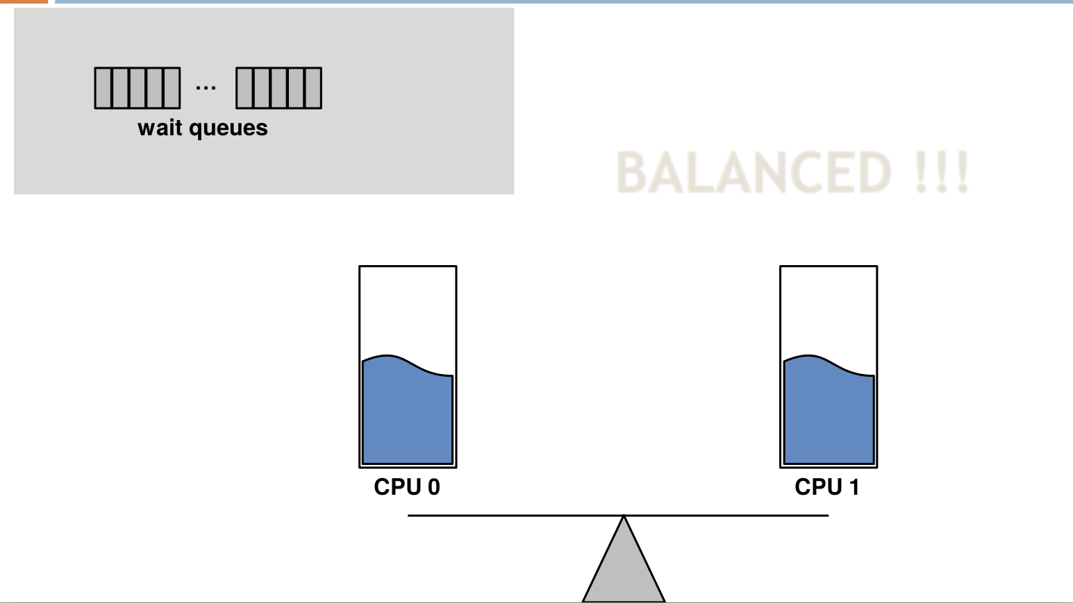
Load Balancing - review
"Energy Aware Scheduling", Byungchul Park, LG Electronic

Slide 7
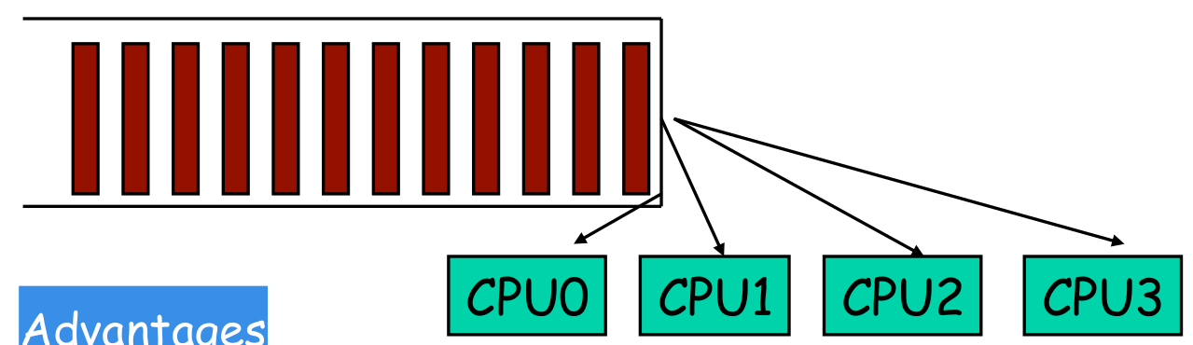
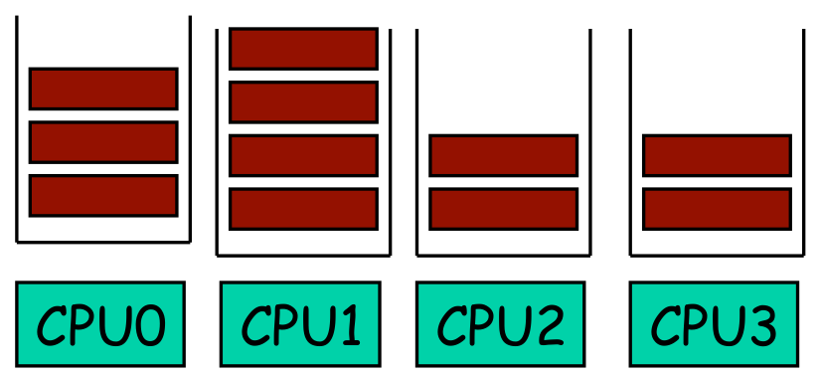
Run over key point again
Global shared runqueue.
expensive synchronized access for global data structure
per-cpu runqueue.
must be kept balanced -> Load balancing

Slide 8
Load balancing
Conceptually, load balancing is simple.
But, modern multicore systems is complex.
Cache data structure, power, big.little, NUMA
To understanding the load balancing algorithm, the load tracking metric must be known.

Slide 9
The load tracking metric.
Load balancer uses to track load.
Easy metric method

Slide 10
The load tracking metric.
Load balancer uses to track load.
Easy metric method
Balancing with Number of threads
Number of threads metric
problem

Slide 11
The load tracking metric.
Load balancer uses to track load.
Easy metric method
Balancing with Number of threads
Number of threads metric
problem :
queue 1 : high-priority thread queue
queue 2 : low-priority thread queue

Slide 12
The load tracking metric.
Load balancer uses to track load.
Easy metric method
Balancing with Number of threads
Number of threads based load-balancing
problem :
queue 1 : high-priority thread queue
queue 2 : low-priority thread queue
Solution
To balance the queues based on thread’s weights, not their number.

Slide 13
Balancing with Number of threads
Problem
One thread is high priority and nine threads are of low priority.
Queue 1: one thread (high priority)
Queue 2: nine threads (low priority
Work-stealing
When high priority thread often sleep.
It may frequently steal work from queue2 to queue1.

Slide 14
Balancing with thread’s weights
Problem
One thread is high priority and nine threads are of low priority.
Queue 1: one thread (high priority)
Queue 2: nine threads (low priority
Work-stealing
When high priority thread often sleep.
It may frequently steal work from queue2 to queue1.
Solution

Slide 15
Balancing with thread’s weights
Problem
One thread is high priority and nine threads are of low priority.
Queue 1: one thread (high priority)
Queue 2: nine threads (low priority
Work-stealing
When high priority thread often sleep.
It may frequently steal work from queue2 to queue1.
Solution
Do not just based on weights, but based on combination of thread’s weight and its average CPU utilization.
CFS’s load
Thread’s weight and its average CPU utilization

Slide 16
CFS load balancer
Problem
Consider
multithreading in different processes.
process 1 : lots of threads.
process 2 : few threads.
Result

Slide 17
CFS load balancer
Problem
Consider
multithreading in different processes.
process 1 : lots of threads.
process 2 : few threads.
Result
process 1 : receive a lot more CPU time than process 2
process 2 : starvation
This would be unfair.

Slide 18
CFS load balancer
Problem
Consider
multithreading in different processes.
process 1 : lots of threads.
process 2 : few threads.
Result
process 1 : receive a lot more CPU time thad process 2
process 2 : starvation
This would be unfair.
Solution
Linux added a group scheduling feature to bring fairness between groups of threads

Slide 19
Linux Group Scheduling
Group scheduling is enabled
CONFIG_FAIR_GROUP_SCHED
A group of tasks is called a “scheduling entity”
struct sched_entity { struct load_weight load; struct sched_entity *parent; struct cfs_rq *cfs_rq; struct cfs_rq *my_rq; struct sched_avg avg; /* ... */ };

Slide 20
Group Scheduling Data Structure
Scheduling is always at the granularity of sched_entity
A single task becomes a scheduling entity
Each scheduling entity contains a runqueue.
struct task_struct { struct sched_entity se; /* ... */ };
struct cfs_rq { struct load_weight load; unsigned long runnable_load_avg; unsigned long blocked_load_avg; unsigned long tg_load_contrib; /* ... */ };

Slide 21
Group Scheduling Data Structure
Extend the concept to multiprocessor
c is CPU NUM
struct task_group { struct sched_entity **se; struct cfs_rq **cfs_rq; unsigned long shares; atomic_long_t load_avg; /* ... */ };
tg->se[c] = &se; tg->cfs_rq[c] = &se->my_q;

Slide 22
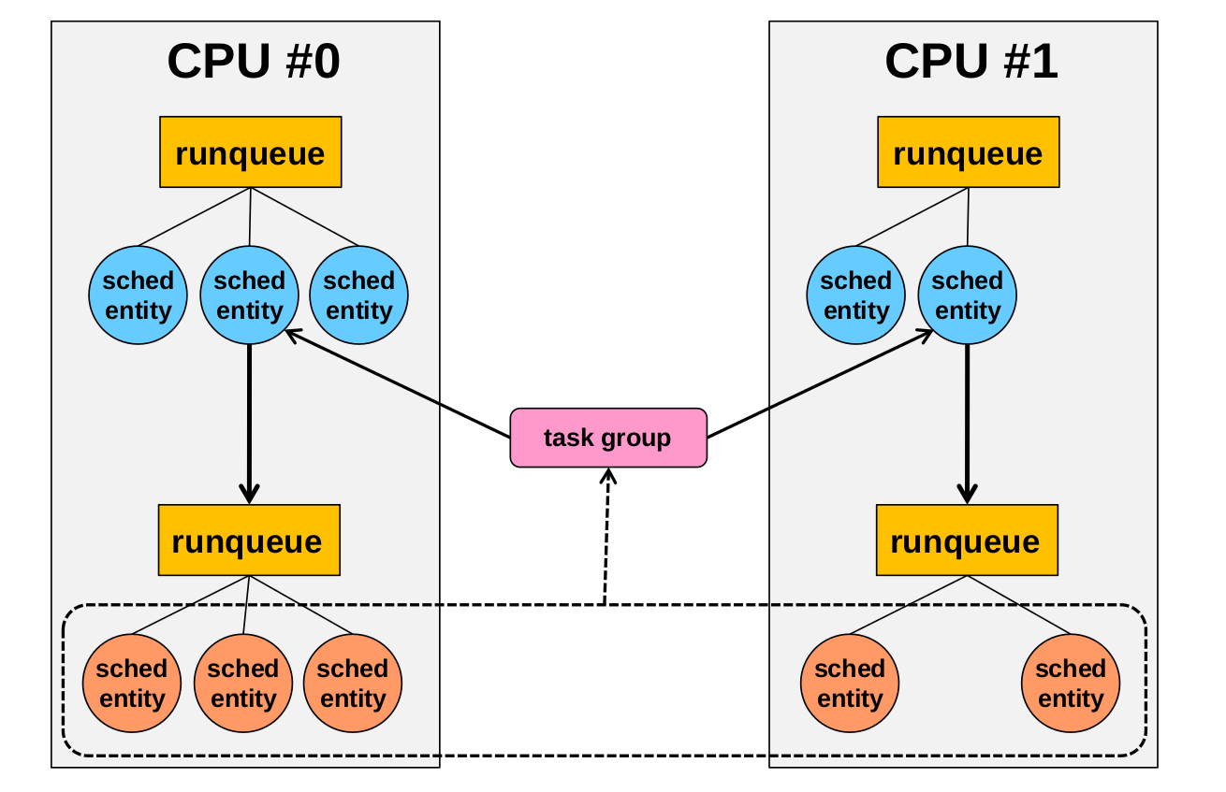
Group Scheduling Data Structure
http://rtcc.hanyang.ac.kr/rtccw/?page_id=1745

Slide 23
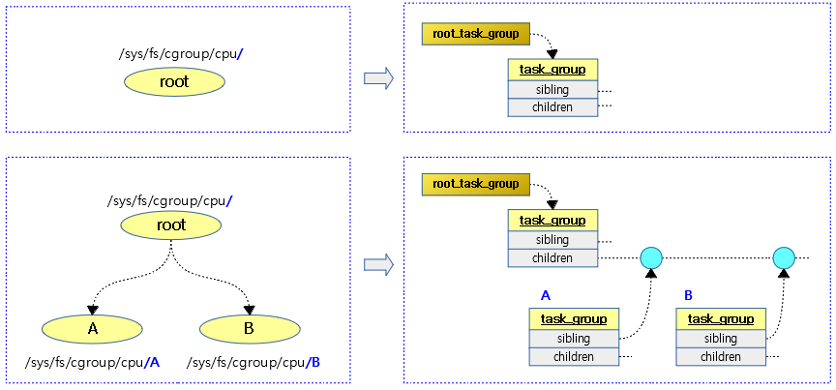
Group Scheduling Data Structure
http://jake.dothome.co.kr/

Slide 24
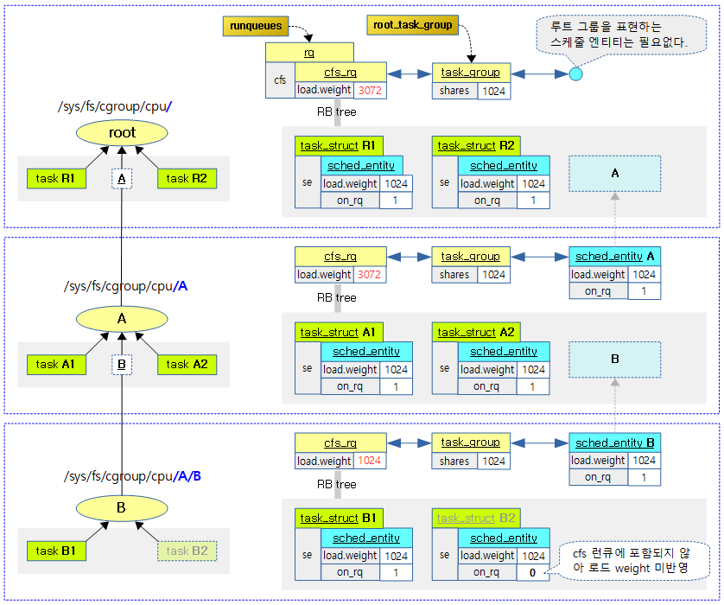
http://jake.dothome.co.kr/

Slide 25
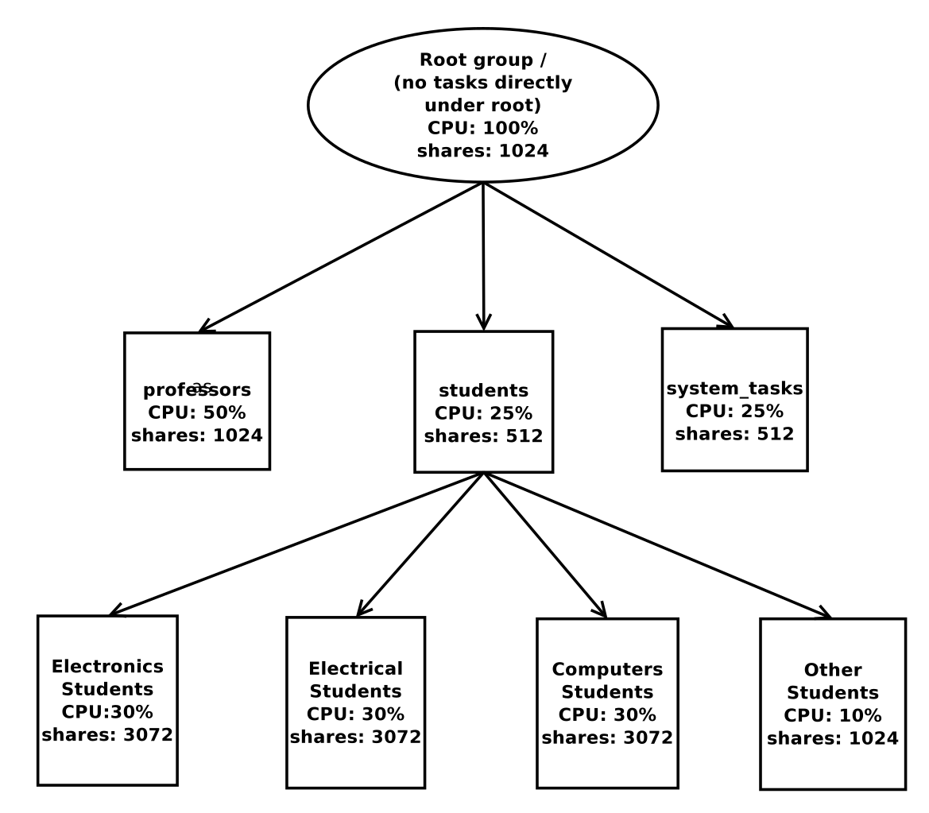
Linux Group Scheduling

Slide 26
CFS load balancer
Problem
When there is free CPU time available
The CPU go idle X
The CFS scheduler will give any left-over time to other processes
Sometimes system administrator may want to limit maximum share of CPU time
The CFS scheduler cannot limit CPU time.

Slide 27
CFS bandwidth control feature
Problem
When there is free CPU time available
The CPU go idle X
The CFS scheduler will give any left-over time to other processes
Sometimes system administrator may want to limit maximum share of CPU time
The CFS scheduler cannot limit CPU time.
Solution
Linux added a CFS bandwidth control feature to limit Limiting the maximum share of CPU time that a process (or group of processes).

Slide 28
CFS bandwidth control
Example use cases
Virtual Machines
Pay-per-use

Slide 29
CFS bandwidth control - two knobs
cpu.cfs_period_us :
The period over which the group's CPU usage is to be regulated
cpu.cfs_quota_us :
how much CPU time is available to the group over that period

Slide 30
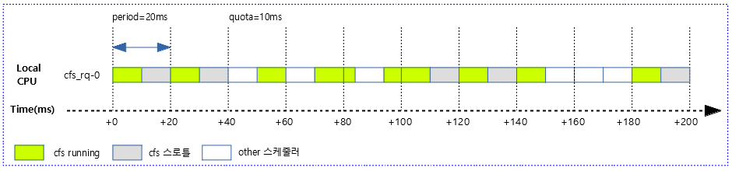
CFS bandwidth control - two knobs
http://jake.dothome.co.kr/

Slide 31
CFS load balancer
Problem
Hardware topologies are becoming more varied, accommodating different power/performance budgets:
SMP, NUMA, ARM big.LITTLE technology.
Modern hardware composed of hierarchy levels of subsystems

Slide 32
Scheduling domain
Problem
Hardware topologies are becoming more varied, accommodating different power/performance budgets:
SMP, NUMA, ARM big.LITTLE technology.
Modern hardware composed of hierarchy levels of subsystems
Solution
Linux added a scheduling domain feature to cover various multi-core systems such as cache architecture, NUMA, heterogeneous systems.

Slide 33
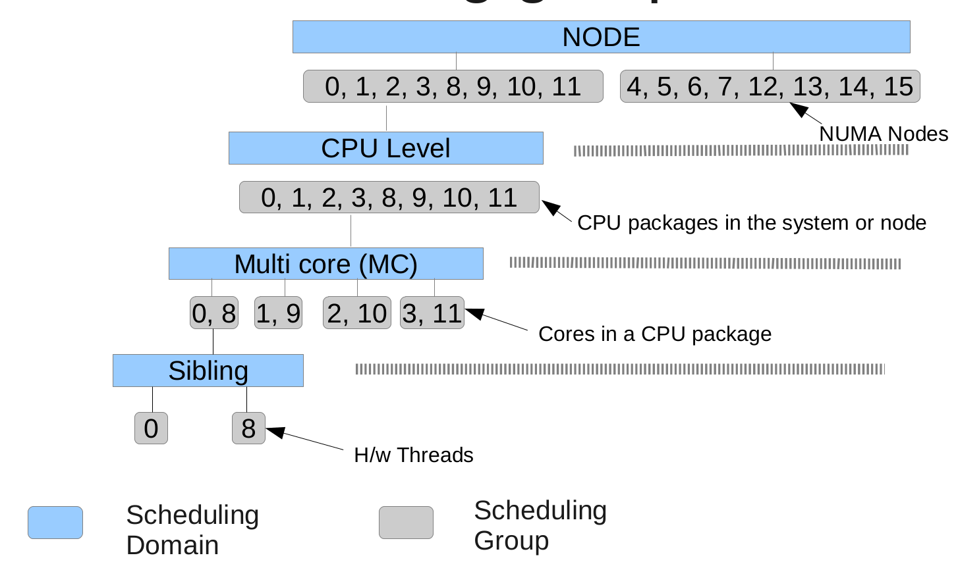
CFS Scheduling Domains

Slide 34
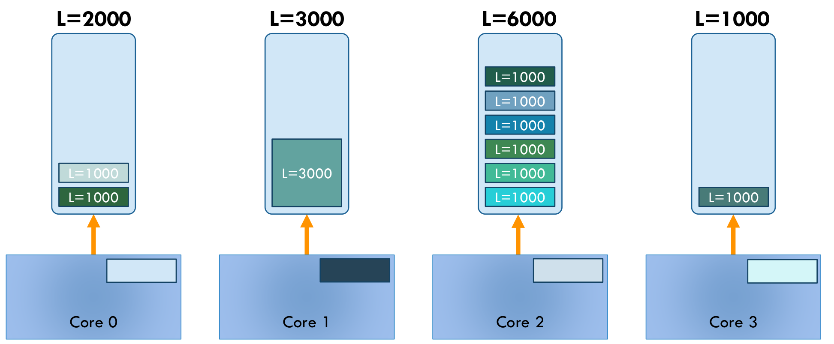
HIERARCHICAL LOAD BALANCING
“THE LINUX SCHEDULER:
A DECADE OF WASTED CORES”, EuroSys’16, Jean-Pierre Lozi, et,.al.

Slide 35
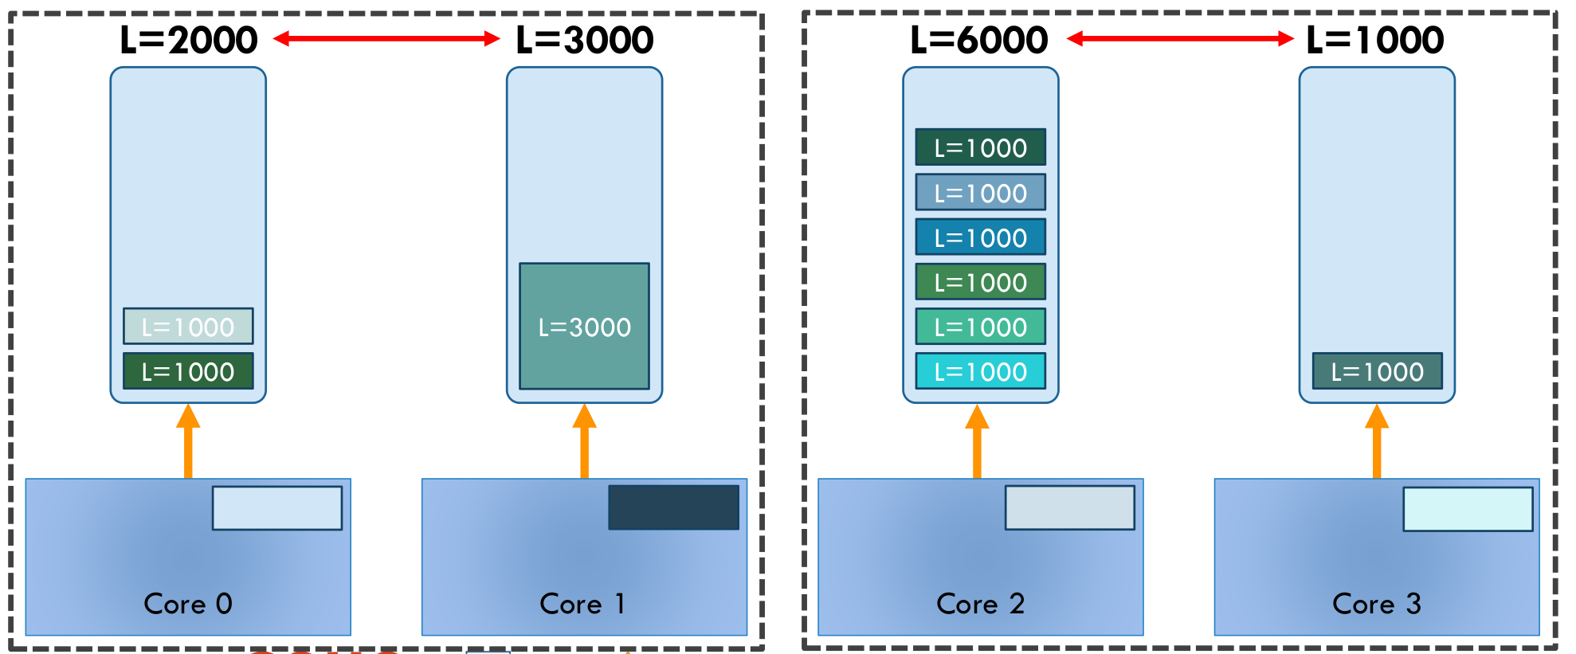
HIERARCHICAL LOAD BALANCING
“THE LINUX SCHEDULER:
A DECADE OF WASTED CORES”, EuroSys’16, Jean-Pierre Lozi, et,.al.

Slide 36
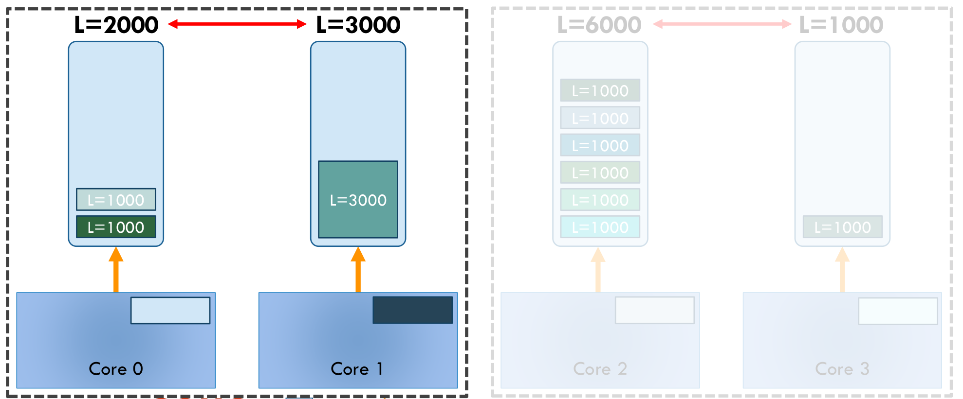
HIERARCHICAL LOAD BALANCING
“THE LINUX SCHEDULER:
A DECADE OF WASTED CORES”, EuroSys’16, Jean-Pierre Lozi, et,.al.

Slide 37
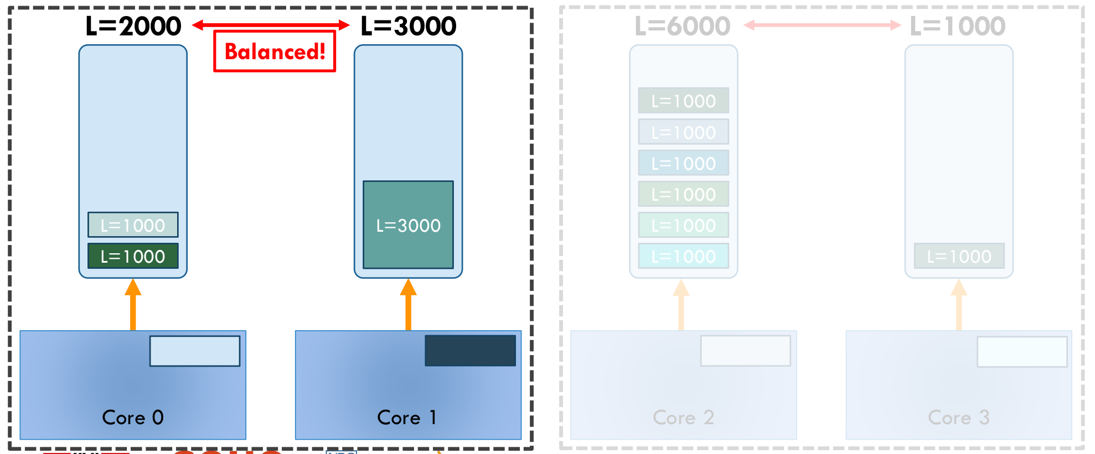
HIERARCHICAL LOAD BALANCING
“THE LINUX SCHEDULER:
A DECADE OF WASTED CORES”, EuroSys’16, Jean-Pierre Lozi, et,.al.

Slide 38
rebalance_domains()
kernel/sched/fair.c

Slide 39
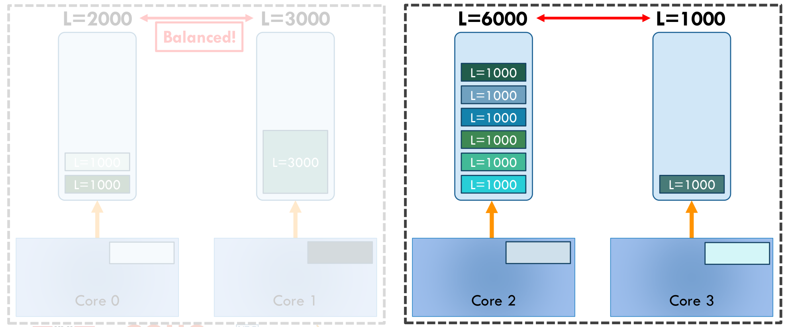
HIERARCHICAL LOAD BALANCING
“THE LINUX SCHEDULER:
A DECADE OF WASTED CORES”, EuroSys’16, Jean-Pierre Lozi, et,.al.

Slide 40
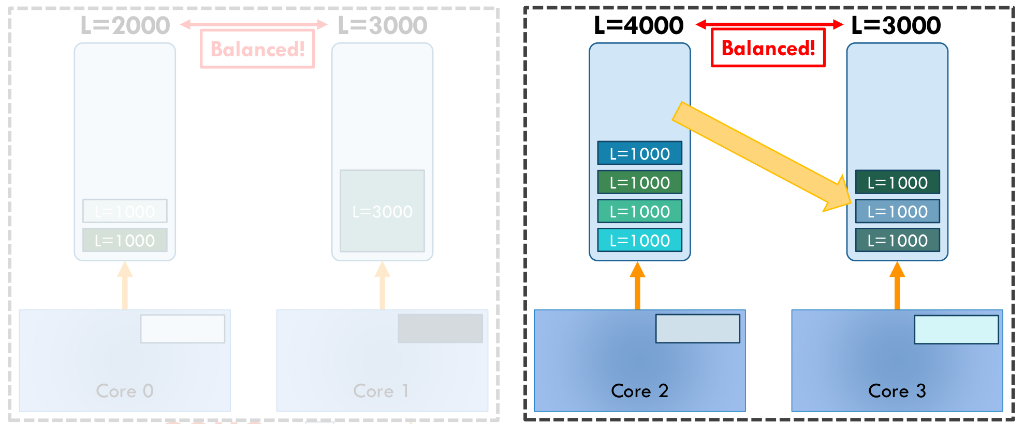
HIERARCHICAL LOAD BALANCING
“THE LINUX SCHEDULER:
A DECADE OF WASTED CORES”, EuroSys’16, Jean-Pierre Lozi, et,.al.

Slide 41
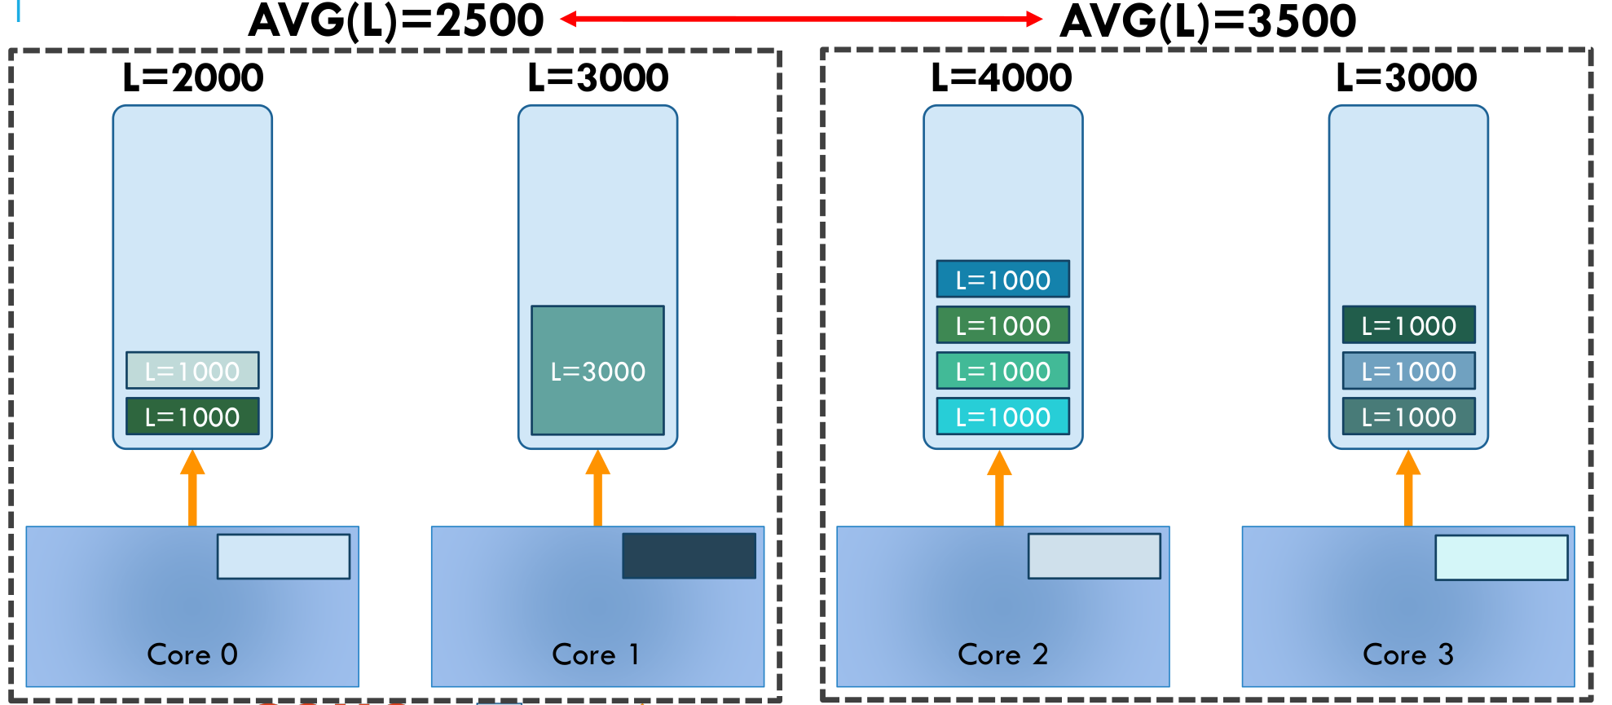
HIERARCHICAL LOAD BALANCING
“THE LINUX SCHEDULER:
A DECADE OF WASTED CORES”, EuroSys’16, Jean-Pierre Lozi, et,.al.

Slide 42
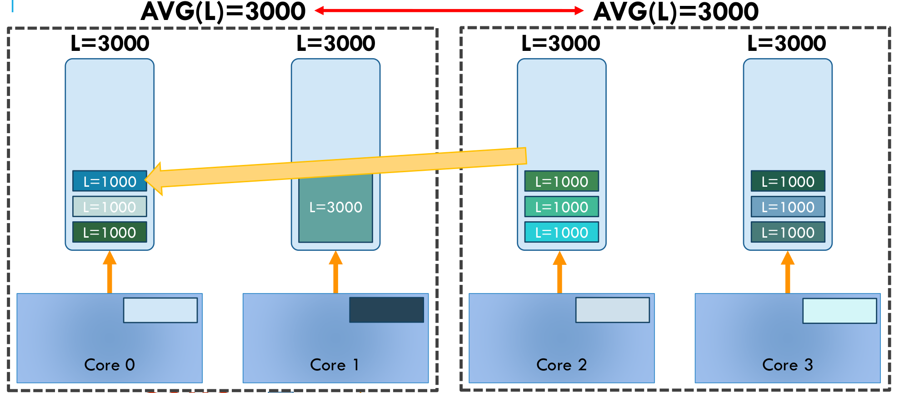
HIERARCHICAL LOAD BALANCING
“THE LINUX SCHEDULER:
A DECADE OF WASTED CORES”, EuroSys’16, Jean-Pierre Lozi, et,.al.

Slide 43
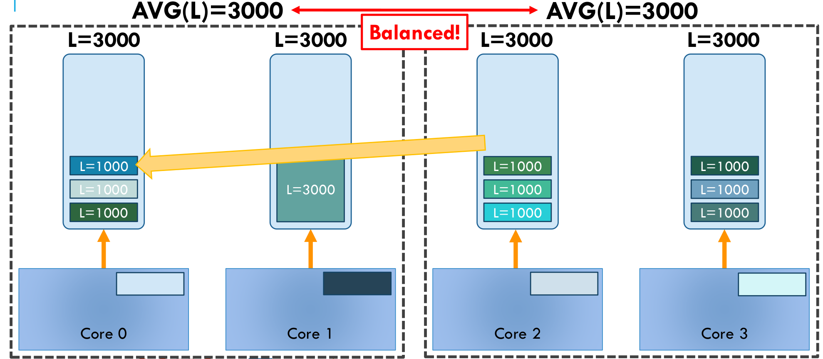
HIERARCHICAL LOAD BALANCING
“THE LINUX SCHEDULER:
A DECADE OF WASTED CORES”, EuroSys’16, Jean-Pierre Lozi, et,.al.

Slide 44
load_balance()
kernel/sched/fair.c

Slide 45
CFS load balancer
Problem
How much is a process loading the system right now?
a bursty or a steady task?
a CPU-intensive or an I/O-bound task?
It does not matter for scheduling
It does matter for load balancing

Slide 46
CFS Per-entity load tracking feature
Problem
How much is a process loading the system right now?
a bursty or a steady task?
a CPU-intensive or an I/O-bound task?
It does not matter for scheduling
It does matter for load balancing
Solution
Linux added a CFS Per-entity load tracking feature to estimate a task load.

Slide 47
CFS load
Load of a process is important in scheduling
which is required during load balancing.
CFS’s load
Thread’s weight and its average CPU utilization
Load of CPU have been the sum of the load of all the scheduling entities.

Slide 48
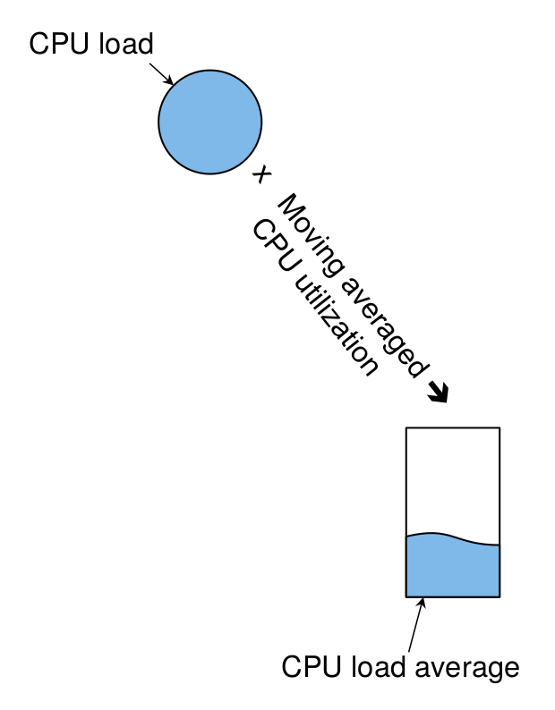
CFS load
"Energy Aware Scheduling", Byungchul Park, LGE

Slide 49
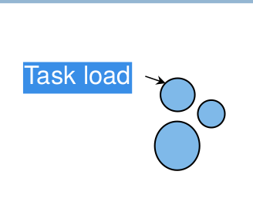
CFS load
"Energy Aware Scheduling", Byungchul Park, LGE

Slide 50
Per-entity load avg
Scheduling is always at the granularity of sched_entity
A single task becomes a scheduling entity
Each scheduling entity contains a runqueue.
struct sched_avg {
u64 last_update_time, load_sum;
u32 util_sum, period_contrib;
unsigned long load_avg, util_avg;
};

Slide 51
load tracking
Formula gives the most weight to the most recent load
y has been chosen so that y³² (32ms) is equal to 0.5
y⁰ = 1,
y¹ = 0.97852
...
y³² = 0.5
Time is viewed as a sequence of 1ms (actually, 1024µs) periods
L = L₀ + L₁*y + L₂*y² + L₃*y³ + …

Slide 52
load tracking
PELT
L = L₀ + L₁*y + L₂*y² + L₃*y³ + …
CFS’s load
Thread’s weight and its average CPU utilization
Old version
sa.load_avg_contrib =
(sa.runnable_sum * se.load.weight) / sa.runnable_period;
-> Rewrite runnable load and utilization
New version
load_avg : PELT(running time + runnable time) * weight
util_avg : PELT(running time) * CPU invariant

Slide 53
__update_load_avg()
kernel/sched/fair.c

Slide 54
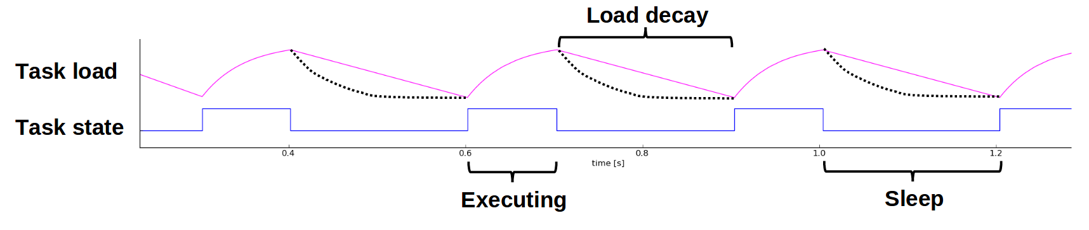
Per-entity load tracking
The load is a history of time spent on the runqueue
“Update on big.LITTLE scheduling experiments”, ARM

Slide 55
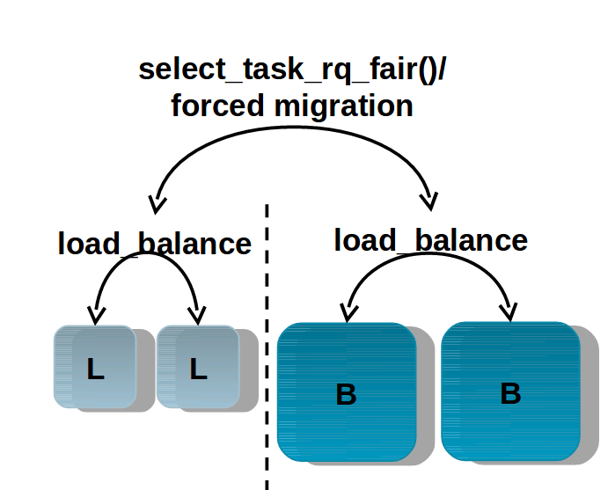
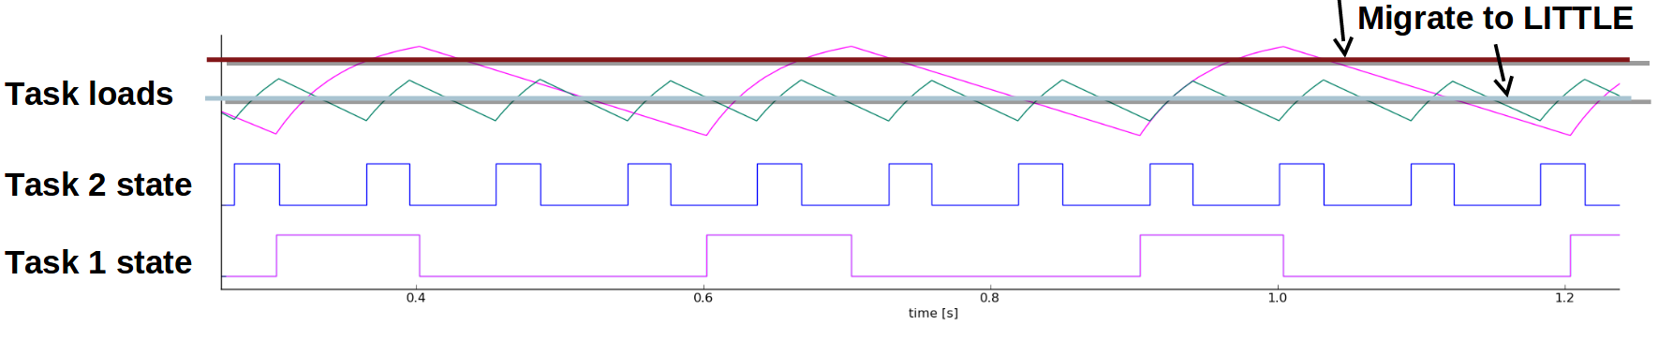

Example use cases
HMP scheduler

Slide 56

Next Step.
Energy-aware scheduling: EAS
EAS features

Slide 57
Reference
https://pdos.csail.mit.edu/6.828/2016/schedule.html
http://web.mit.edu/6.033
http://www.rdrop.com/~paulmck/
“Is Parallel Programming Hard, And If So, What Can You Do About It?”
Davidlohr Bueso. 2014. Scalability techniques for practical synchronization primitives. Commun. ACM 58
http://queue.acm.org/detail.cfm?id=2698990
"CPUFreq and The Scheduler Revolution in CPU Power Management", Rafael J. Wysocki
https://sites.google.com/site/embedwiki/oses/linux/pm/pm-qos
https://intl.aliyun.com/forum/read-916
User-level threads : co-routines
http://www.gamedevforever.com/291
https://www.youtube.com/watch?v=YYtzQ355_Co
Scheduler Activations
https://cgi.cse.unsw.edu.au/~cs3231/12s1/lectures/SchedulerActivations.pdf
https://en.wikipedia.org/wiki/FIFO_(computing_and_electronics)
http://jake.dothome.co.kr/
http://www.linuxjournal.com/magazine/completely-fair-scheduler?page=0,0
https://www2.cs.uic.edu/~jbell/CourseNotes/OperatingSystems/6_CPU_Scheduling.html
"Energy Aware Scheduling", Byungchul Park, LG Electronic
“Update on big.LITTLE scheduling experiments”, ARM
“EAS Update” 2015 september ARM
"EAS Overview and Integration Guide”, ARM TR
“Drowsy Power Management”, Matthew Lentz, SOSP 2015
https://www.slideshare.net/nanik/learning-aosp-android-hardware-abstraction-layer-hal
https://www.youtube.com/watch?v=oTGQXqD3CNI
https://www.youtube.com/watch?v=P80NcKUKpuo
https://lwn.net/Articles/398470/
“SCHED_DEADLINE: It’s Alive!”, ARM, 2017

